Slide 1
COMPUTER ORGANIZATION AND ARCHITECTURE
J. FATHIMA FOUZIA
Assistant Professor
Department of CS & IT
Jamal Mohamed College (Autonomous)
Trichy - 620020

Slide 2
LOGIC GATES
Gates are blocks of hardware that produce graphic symbol and its operation can be described by means of an algebraic expression.
The input-output relationship of the binary variables for each gate can be represented in tabular form by a truth-table.
The most basic logic gates are AND and OR with multiple inputs and NOT with a single input.

Slide 3
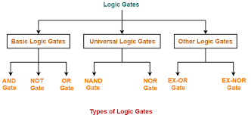
TYPES OF LOGIC GATES
The various logical gates are:
AND
OR
NOT
NAND
NOR
XOR
XNOR

Slide 4
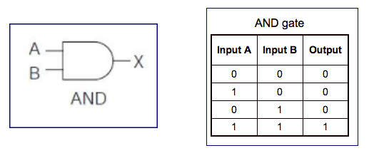
AND GATE
The AND gate produces the logic AND function, ie.,the output is 1 if both the inputs A and B are 1, otherwise the output is 0
The algebraic symbol is ‘dot’, same as multiplication, ie., F=A.B or AB

Slide 5
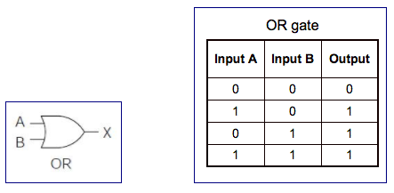
OR GATE
The OR gate produces the OR function, ie., the output is 1 if A or B or both are equal to 1, otherwise 0.
The algebraic symbol is ‘+’, same as addition, ie., F=A+B

Slide 6
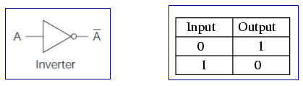
NOT (INVERTER) GATE
The inverter circuit inverts the logic sense of a binary signal. It produces the NOT, or complement, function.
The algebraic symbol used for the logic complement is either a prime or a bar over the variable symbol, ie., F=A’

Slide 7
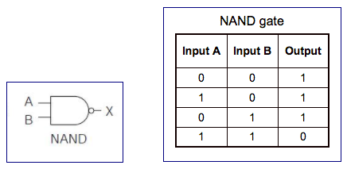
NAND GATE
The NAND function is the complement of the AND function, as indicated by the graphic symbol, which consists of an AND graphic symbol followed by a small circle, F=(A.B)’
The designation NAND is derived from the abbreviation of NOT-AND.

Slide 8
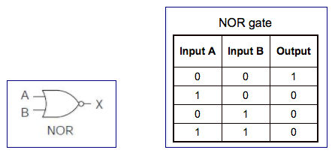
NOR GATE
The NOR gate is the complement of the OR gate and uses an OR graphic symbol followed by a small circle, F=(A+B)’

Slide 9
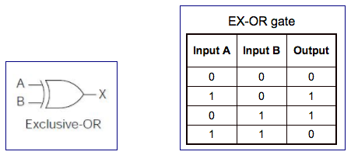
EXCLUSIVE OR GATE
The exclusive-OR gate has a graphic symbol similar to the OR gate except for the additional curved line on the input side.
The output of the gate is 1 if any input is 1 but excludes the combination when both inputs are 1. It is similar to an odd function; that is, its output is 1 if an odd number of inputs are 1,F=A’B+AB’

Slide 10
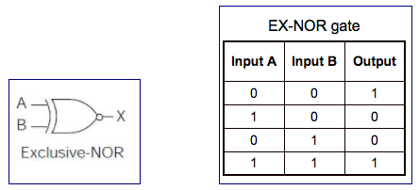
EXCLUSIVE NOR GATE
The exclusive-NOR is the complement of the exclusive-OR, as indicated by the small circle in the graphic symbol.
The output of this gate is 1 only if both the inputs are equal to 1 or both inputs are equal to 0,F=AB+A’B’

Slide 11
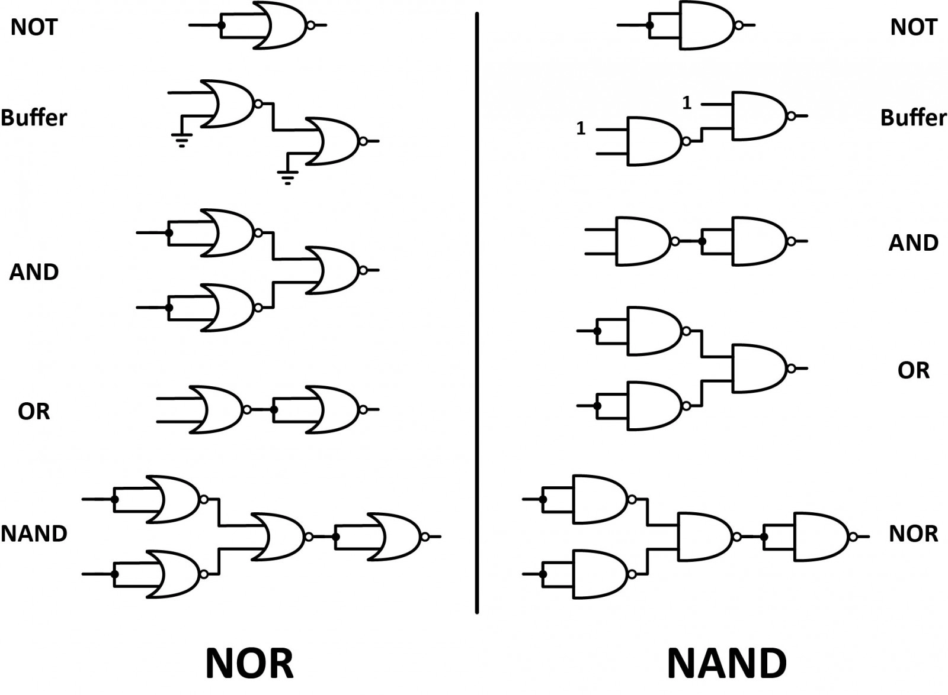
UNIVERSAL LOGIC

Slide 12
Boolean laws and theorems

Slide 13
BOOLEAN ALGEBRA
Boolean Algebra is an algebra, which deals with binary numbers & binary variables.
A mathematician, named George Boole had developed this algebra in 1854.
The variables used in this algebra are also called as boolean variables.

Slide 14
Boolean Postulates – logical or
Either the boolean variable or complement of it is known as literal. The four possible logical OR operations among these literals and binary numbers are,
          x + 0 = x ➔ 0+0=0 ; 1+0=1
          x + 1 = 1 ➔ 0+1=1 ; 1+1=1
          x + x = x ➔ 0+0=0 ; 1+1=1
          x + x’ = 1 ➔ 0+1=1 ; 1+0=1

Slide 15
Boolean Postulates – logical and
The four possible logical AND operations among those literals and binary numbers are,
        x.1 = x ➔ 0.1=0 ; 1.1=1
        x.0 = 0 ➔ 0.0=0 ; 1.0=0
        x.x = x ➔ 0.0=0 ; 1.1=1
        x.x’ = 0 ➔ 0.1=0 ; 1.0=0

Slide 16
Basic Laws of Boolean Algebra
Following are the three basic laws of boolean algebra.
  Commutative law
  Associative law
  Distributive law

Slide 17
Commutative Law
If any logical operation of two boolean variables give the same result irrespective of the order of those two variables, then that logical operation is said to be commutative. The logical OR & logical AND operations of two boolean variables x & y are shown below
    x + y = y + x ➔ 0+1=1+0
    x.y = y.x ➔ 0.1=1.0
The symbol ‘+’ indicates logical OR operation. Similarly, the symbol ‘.’ indicates logical AND operation and it is optional to represent. Commutative Law obeys for logical OR & logical AND operations.

Slide 18
Associative Law
If a logical operation of any two boolean variables is performed first and then the same operation is performed with the remaining variable gives the same result, then that logical operation is said to be associative. The logical OR & logical AND operations of three boolean variables x, y & z are shown below.
    X + (Y + Z) = (X + Y) + Z ➔ 0+(1+0)=(0+1)+0
    X . (Y.Z) = (X.Y).Z ➔ 0.(1.0)=(0.1).0
Associative law obeys for logical OR & logical AND operations.

Slide 19
Distributive Law
If any logical operation can be distributed to all the terms present in the boolean function, then that logical operation is said to be distributive. The distribution of logical OR & logical AND operations of three boolean variables x, y & z are shown below.
  X(Y + Z) = X.Y + X.Z ➔ 1(0+1)=1.0+1.1
  X + (Y.Z) = (X + Y).(X + Z) ➔ 1+(0.1)=(1+0).(1+1)
Distributive law obeys for logical OR and logical AND operations.

Slide 20
Annulment Law
A term and´ed with a “0” equals 0 or or´ed with a “1” will equal 1
  A . 0 = 0 ➔ 0.0 =0 ; 1.0=0
  A + 1 = 1 ➔ 0+1=1 ; 1+1=1

Slide 21
IDENTITY LAW
A term or´ed with a “0” or and´ed with a “1” will always equal that term
  A + 0 = A ➔ 0+0=0 ; 1+0=1
  A . 1 = A ➔ 0.1=0 ; 1.1=1

Slide 22
IDEMPOTENT LAW
an input that is and´ed or or´ed with itself is equal to that input
  A + A = A ➔ 0+0=0 ; 1+1=1
  A . A = A ➔ 0.0=0 ; 1.1=1

Slide 23
COMPLEMENT LAW
A term and´ed with its complement equals “0” and a term or´ed with its complement equals “1”
  A . A’ = 0 ➔ 0.1=0 ; 1.0=0
  A + A’ = 1 ➔ 0+1=1 ; 1+0=1

Slide 24
DOUBLE NEGATION LAW
A term that is inverted twice is equal to the original term
  (A’)’ = A
  (0’)’ = 0
  (1’)’ = 1

Slide 25
AbsorptiON Law
This law enables a reduction in a complicated expression to a simpler one by absorbing like terms.
  A + (A.B) = A ➔ 0+(0.1)=0
  A(A + B) = A ➔ 0(0+1)=0

Slide 26
Theorems of Boolean Algebra
The following two theorems are used in boolean algebra.
  Duality theorem
  Demorgan’s theorem

Slide 27
Duality Theorem
This theorem states that the dual of the boolean function is obtained by interchanging the logical AND operator with logical OR operator and zeros with ones. For every boolean function, there will be a corresponding dual function.

Slide 28
DUALITY THEOREM
Group1 | Group2
x + 0 = x; 0+0=0;1+0=0 | x.1 = x; 0.1=0;1.1=1
x + 1 = 1; 0+1=1;1+1=1 | x.0 = 0; 0.0=0;1.0=0
x + x = x; 0+0=0;1+1=1 | x.x = x; 0.0=0;1.1=1
x + x’ = 1;0+1=1;1+0=1 | x.x’ = 0; 0.1=0;1.0=0
x + y = y + x | x.y = y.x
x + (y+z) = (x+y) + z | x.(y.z) = (x.y).z
x.(y+z) = x.y + x.z | x +(y.z) = (x+y).(x+z)

Slide 29
DeMorgan’s Theorem
DeMorgan’s FIRST LAW
It states that the complement of logical OR of at least two boolean variables is equal to the logical AND of each complemented variable.
(A+B)’ = A’.B’

Slide 30
DeMorgan’s Theorem
DeMorgan’s SECOND LAW
It states that The complement of logical AND of two boolean variables is equal to the logical OR of each complemented variable.
(AB)’ = A’+B’

Slide 31
Boolean expressions SOP & POS

Slide 32
BOOLEAN EXPRESSION
A boolean expression always produces a boolean value.
A boolean expression is composed of a combination of the boolean constants (true or false), boolean variables and logical connectives.
Each boolean expression represents a boolean function.

Slide 33
Canonical Forms
For a boolean expression there are two kinds of canonical forms
  The sum of products (SOP) form
  The product of sums (POS) form

Slide 34
Sum of products form
A minterm is a product of all variables taken either in their direct or complemented form.
Any boolean function can be expressed as a sum of its 1-minterms and the inverse of the function can be expressed as a sum of its 0-minterms. Hence,
F (list of variables) = ∑ (list of 1-minterm indices) And
F' (list of variables) = ∑ (list of 0-minterm indices)

Slide 35
Three variable sop form
A B C FP Minterm
0 0 0 A’B’C’ m0
0 0 1 A’B’C m1
0 1 0 A’BC’ m2
0 1 1 A’BC m3
1 0 0 AB’C’ m4
1 0 1 AB’C m5
1 1 0 ABC’ m6
1 1 1 ABC m7

Slide 36
SUM OF PRODUCTS EQUATION
To frame an equation using SOP we have to locate each output 1(min term) in the truth table and write down the fundamental product
Example:
  Y = A’BC + AB’C + ABC’ + ABC (OR)
  Y = F (A, B, C) = ∑ m (3, 5, 6, 7)

Slide 37
Product of Sums (POS) form
A maxterm is addition of all variables taken either in their direct or complemented form.
Any boolean function can be expressed as a product of its 0-maxterms and the inverse of the function can be expressed as a product of its 1-maxterms. Hence,
F(list of variables) = π (list of 0-maxterm indices). And
F'(list of variables) = π (list of 1-maxterm indices).

Slide 38
Three variable pos form
X Y Z Term Maxterm
0 0 0 x + y + z M0
0 0 1 x + y + z’ M1
0 1 0 x + y’ + z M2
0 1 1 x + y’ + z’ M3
1 0 0 x’ + y + z M4
1 0 1 x’ + y + z’ M5
1 1 0 x’ + y’ + z M6
1 1 1 x’ + y’ + z’ M7

Slide 39
PRODUCT OF SUMS EQUATION
To frame an equation using POS we have to locate each output 0 (Max term) in the truth table and write down the fundamental sum
Example:
  Y = (A + B + C)(A + B’ + C’)(A’ + B’ + C) (OR)
  Y = F (A, B, C) = π m (0, 3, 6)

Slide 40
Examples for sop and pos
Sop
  F(a, b, c) = ab + b’c + ac
  F(a, b, c) = a’b + bc’ + bc + ab’c’
Pos
  F(a, b, c) = (a+b+c).(a’+b+c’)
  F(a, b, c) = (a’+b’+c’) . (b’+c)

Slide 41
Simplification of Boolean expressions

Slide 42
Karnaugh map
Karnaugh introduced a method for simplification of boolean functions in an easy way.
This method is known as karnaugh map method or k-map method.
The karnaugh map is a two dimensional representation of a truthtable.
It is a graphical method, which consists of 2^{n} cells for ‘n’ variables. The adjacent cells are differed only in single bit position.

Slide 43
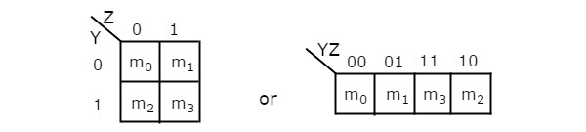
2-Variable K-Map
The number of cells in 2 variable k-map is four, since the number of variables is two. The following figure shows 2 variable k-map.

Slide 44
2-Variable K-Map
There is only one possibility of grouping 4 adjacent min terms.
The possible combinations of grouping 2 adjacent min terms are
  {(m0, m1),
  (m2, m3),
  (m0, m2) and
  (m1, m3)}.

Slide 45

3-Variable K-Map
The number of cells in 3 variable k-map is eight, since the number of variables is three. The following figure shows 3 variable k-map.

Slide 46
3-Variable K-Map
There is only one possibility of grouping 8 adjacent min terms.
The possible combinations of grouping 4 adjacent min terms are {(m0, m1, m3, m2), (m4, m5, m7, m6), (m0, m1, m4, m5), (m1, m3, m5, m7), (m3, m2, m7, m6) and (m2, m0, m6, m4)}.
The possible combinations of grouping 2 adjacent min terms are {(m0, m1), (m1, m3), (m3, m2), (m2, m0), (m4, m5), (m5, m7), (m7, m6), (m6, m4), (m0, m4), (m1, m5), (m3, m7) and (m2, m6)}.

Slide 47
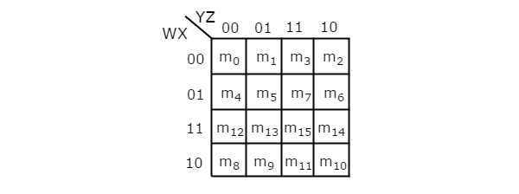
4-Variable K-Map
The number of cells in 4 variable k-map is sixteen, since the number of variables is four. The following figure shows 4 variable k-map.

Slide 48
4-Variable K-Map
There is only one possibility of grouping 16 adjacent min terms.
Let R1, R2, R3 and R4 represents the min terms of first row, second row, third row and fourth row respectively. Similarly, C1, C2, C3 and C4 represents the min terms of first column, second column, third column and fourth column respectively. The possible combinations of grouping 8 adjacent min terms are {(R1, R2), (R2, R3), (R3, R4), (R4, R1), (C1, C2), (C2, C3), (C3, C4), (C4, C1)}.

Slide 49
Karnaugh Maps - Rules of Simplification
The karnaugh map uses the following rules for the simplification of expressions by grouping together adjacent cells containing ones
No zeros allowed.
No diagonals.
Only power of 2 number of cells in each group.
Groups should be as large as possible.
Every one must be in at least one group.
Overlapping allowed.
Wrap around allowed.
Fewest number of groups possible.

Slide 50
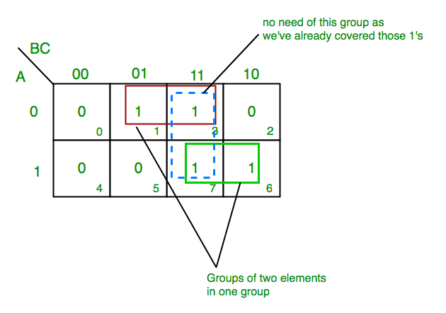
Examples sop form
Z= ∑A,B,C(1,3,6,7)
Final expression
(A’C+AB)

Slide 51
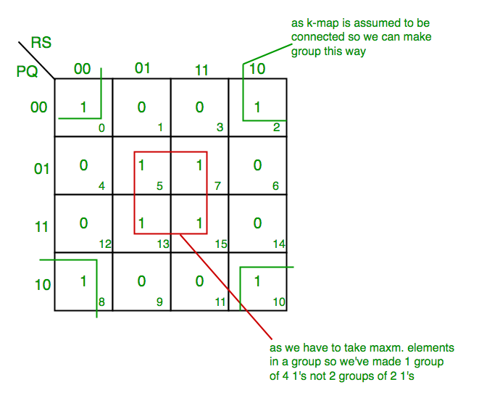
Examples sop form
F(P,Q,R,S)=∑(0,2,5,7,8,10,13,15)
Final expression
(QS+Q’S’)

Slide 52
exercise
1. y = f(a,b,c) = ∑ (1,6,7)
2. y = f(a,b,c) = ∑ (1,2,3,5,7)
3. y = f(a,b,c) = ∑ (0,2,4,6,7)
4. y = f(a,b,c) = ∑ (0,2,5,7,8,10,13,15)
5. y = f(a,b,c) = ∑ (0,1,2,3,4,6,8,9,10,11,12,14)

Slide 53
Multiplexers

Slide 54
multiplexers
A multiplexer is a combinational circuit that has 2^{n} input lines and a single output line.
Simply, the multiplexer is a multi-input and single-output combinational circuit.
The binary information is received from the input lines and directed to the output line.
On the basis of the values of the selection lines, one of these data inputs will be connected to the output.
A multiplexer is also treated as Mux.

Slide 55
types of the multiplexers
There are various types of the multiplexers which are as follows:
  2×1 multiplexer
  4×1 multiplexer
  8 to 1 multiplexer
  8 ×1 multiplexer using 4×1 and 2×1 multiplexer
  16 to 1 multiplexer
  16×1 multiplexer using 8×1 and 2×1 multiplexer

Slide 56
2×1 Multiplexer
In 2×1 multiplexer, there are only two inputs, i.e., A₀ and A₁, 1 selection line, i.e., S₀ and single outputs, i.e., Y.
On the basis of the combination of inputs which are present at the selection line S⁰, one of these 2 inputs will be connected to the output.

Slide 57
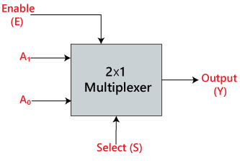
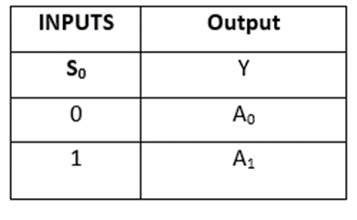
Block diagram & truth table

Slide 58
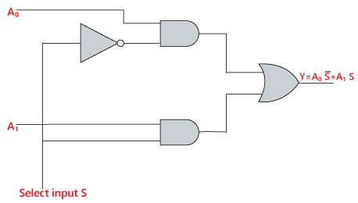
Logic circuit
The logical expression of the term Y is as follows:
  Y=S₀'.A₀+S₀.A₁

Slide 59
4×1 Multiplexer
In the 4×1 multiplexer, there is a total of four inputs, i.e., A₀, A₁, A₂, and A₃, 2 selection lines, i.e., S₀ and S₁ and single output, i.e., Y.
On the basis of the combination of inputs that are present at the selection lines S⁰ and S₁, one of these 4 inputs are connected to the output.

Slide 60
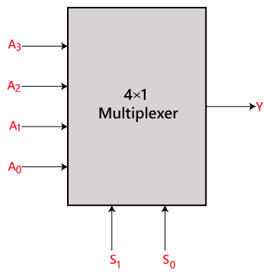
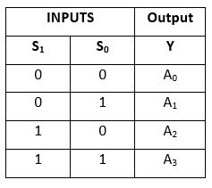
Block diagram & truth table

Slide 61
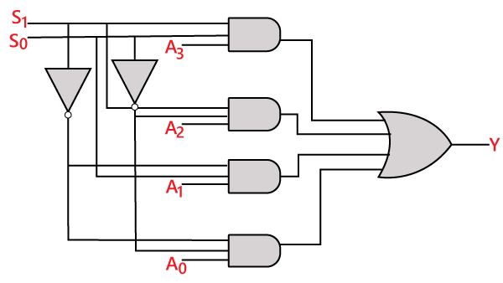
Logic circuit
The logical expression of the term Y is as follows:
Y=S₁' S₀' A₀+S₁' S₀ A₁+S₁ S₀' A₂+S₁ S₀ A₃

Slide 62
8 to 1 Multiplexer
In the 8 to 1 multiplexer, there are total eight inputs, i.e., A₀, A₁, A₂, A₃, A₄, A₅, A₆, and A₇, 3 selection lines, i.e., S₀, s₁and S₂ and single output, i.e., Y.
On the basis of the combination of inputs that are present at the selection lines S⁰, S^{1,} and S₂, one of these 8 inputs are connected to the output.

Slide 63
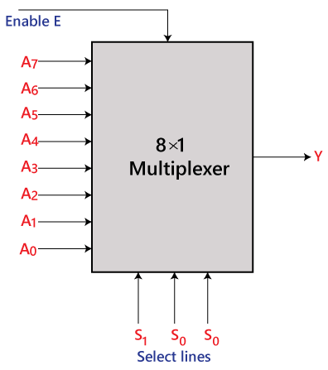
Block diagram

Slide 64
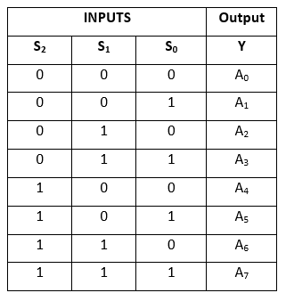
Truth table

Slide 65
Logical expression
The logical expression of the term Y is as follows:
Y=S0'.S1'.S2'.A0 + S0.S1'.S2'.A1 + S0'.S1.S2'.A2 + S0.S1.S2'.A3 + S0'.S1'.S2 A4 + S0.S1'.S2 A5 + S0'.S1.S2 .A6 + S0.S1.S3.A7

Slide 66
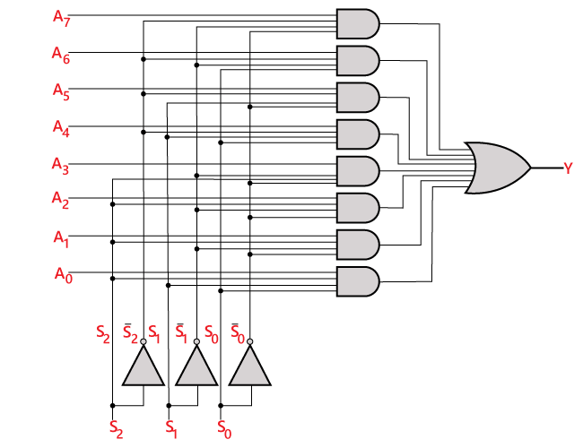
Logic circuit

Slide 67
8 ×1 multiplexer using 4×1 and 2×1 multiplexer
We can implement the 8×1 multiplexer using a lower order multiplexer.
To implement the 8×1 multiplexer, we need two 4×1 multiplexers and one 2×1 multiplexer.
For getting 8 data inputs, we need two 4×1 multiplexers. The 4×1 multiplexer produces one output.
So, in order to get the final output, we need a 2×1 multiplexer.

Slide 68
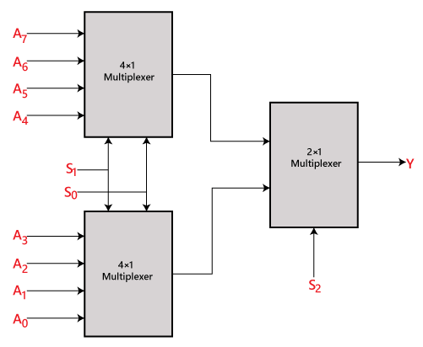
Block diagram

Slide 69
16 to 1 Multiplexer
In the 16 to 1 multiplexer, there are total of 16 inputs, i.e., A₀, A₁, …, A₁₆, 4 selection lines, i.e., S₀, S₁, S₂, and S₃ and single output, i.e., Y.
On the basis of the combination of inputs that are present at the selection lines S⁰, S¹, and S₂, one of these 16 inputs will be connected to the output.

Slide 70
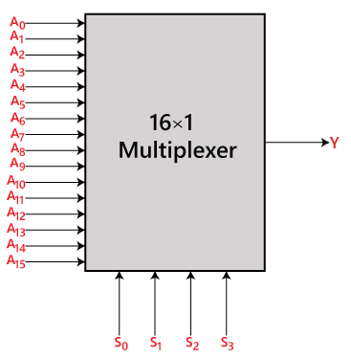
Block diagram

Slide 71
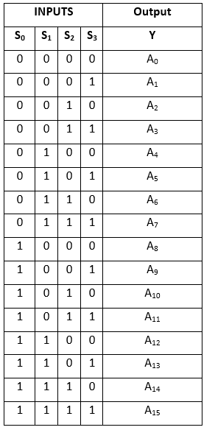
Truth table

Slide 72
Logical expression
Y=A0.S0'.S1'.S2'.S3'+A1.S0'.S1'.S2 '.S3+A2.S0'.S1'.S2.S3'+A3.S0'.S1 '.S2.S3+A4.S0'.S1.S2'.S3'+A5.S0 '.S1.S2'.S3+A6.S1.S2.S3'+A7.S0 '.S1.S2.S3+A8.S0.S1'.S2'.S3'+A9 .S0.S1'.S2'.S3+Y10.S0.S1'.S2.S3 '+A11.S0.S1'.S2.S3+A12 S0.S1.S2 '.S3'+A13.S0.S1.S2'.S3+A14.S0.S1 .S2.S3'+A15.S0.S1.S2'.S3

Slide 73
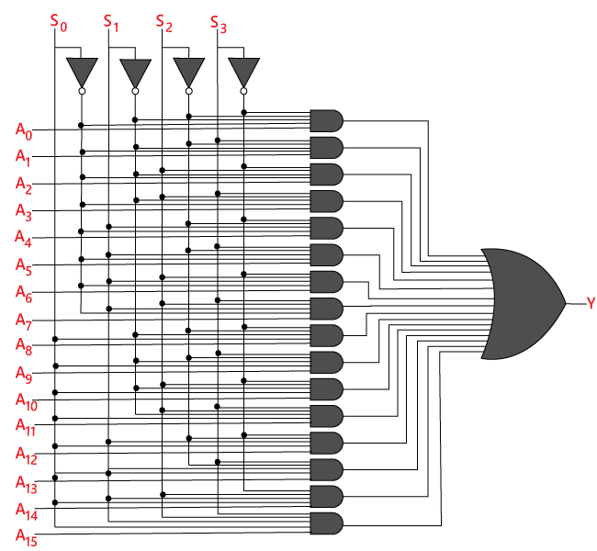
Logic circuit

Slide 74
16×1 multiplexer using 8×1 and 2×1 multiplexer
We can implement the 16×1 multiplexer using a lower order multiplexer.
To implement the 8×1 multiplexer, we need two 8×1 multiplexers and one 2×1 multiplexer.
The 8×1 multiplexer has 3 selection lines, 4 inputs, and 1 output. The 2×1 multiplexer has only 1 selection line.
For getting 16 data inputs, we need two 8 ×1 multiplexers. The 8×1 multiplexer produces one output.
So, in order to get the final output, we need a 2×1 multiplexer.

Slide 75
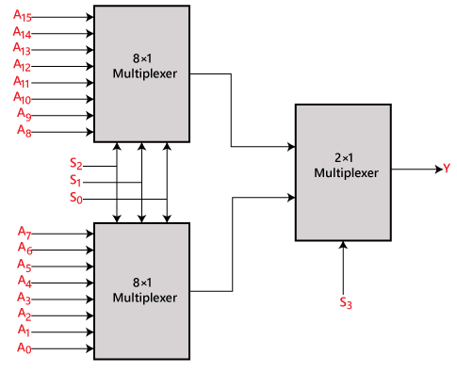
Block diagram

Slide 76
Demultiplexer
De-multiplexer is a combinational circuit that performs the reverse operation of multiplexer.
It has single input, ‘n’ selection lines and maximum of 2^{n} outputs. The input will be connected to one of these outputs based on the values of selection lines.
Since there are ‘n’ selection lines, there will be 2^{n} possible combinations of zeros and ones.
So, each combination can select only one output. De-multiplexer is also called as de-mux.

Slide 77
1x4 De-Multiplexer
1x4 De-multiplexer has one input I, two selection lines, s₁ & s₀ and four outputs Y₃, Y₂, Y₁ &Y₀.
The single input ‘I’ will be connected to one of the four outputs, Y₃ to Y₀ based on the values of selection lines s₁ & s0.

Slide 78
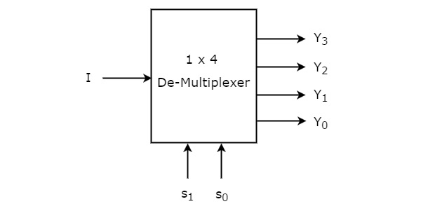
Block diagram & truth table
Selection Inputs |  | Outputs
S₁ | S₀ | Y₃ | Y₂ | Y₁ | Y₀
0 | 0 | 0 | 0 | 0 | I
0 | 1 | 0 | 0 | I | 0
1 | 0 | 0 | I | 0 | 0
1 | 1 | I | 0 | 0 | 0

Slide 79
Boolean function
Y3 = s₁.s₀.i
Y2 = s₁.s₀’.i
Y1 = s₁’.s₀.i
Y0 = s₁’.s₀’.i

Slide 80
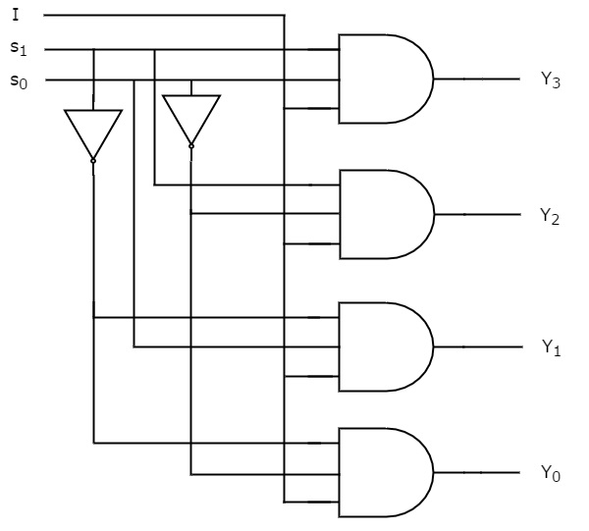
Logic circuit

Slide 81
Implementation of Higher-order De-Multiplexers
Let us implement the following two higher-order de-multiplexers using lower-order de-multiplexers.
1x8 de-multiplexer
1x16 de-multiplexer

Slide 82
1x8 De-Multiplexer
1x8 de-multiplexer is implemented using 1x4 de-multiplexers and 1x2 de-multiplexer.
1x8 de-multiplexer has single input, three selection lines and eight outputs.
So, we require two 1x4 de-multiplexers in second stage in order to get the final eight outputs.
Since, the number of inputs in second stage is two, we require 1x2 demultiplexer in first stage so that the outputs of first stage will be the inputs of second stage.
Input of this 1x2 de-multiplexer will be the overall input of 1x8 de-multiplexer.

Slide 83
truthtable
SELECTION INPUTS |  |  | OUTPUTS
S₂ | S₁ | S₀ | Y₇ | Y₆ | Y₅ | Y₄ | Y₃ | Y₂ | Y₁ | Y₀
0 | 0 | 0 | 0 | 0 | 0 | 0 | 0 | 0 | 0 | I
0 | 0 | 1 | 0 | 0 | 0 | 0 | 0 | 0 | I | 0
0 | 1 | 0 | 0 | 0 | 0 | 0 | 0 | I | 0 | 0
0 | 1 | 1 | 0 | 0 | 0 | 0 | I | 0 | 0 | 0
1 | 0 | 0 | 0 | 0 | 0 | I | 0 | 0 | 0 | 0
1 | 0 | 1 | 0 | 0 | I | 0 | 0 | 0 | 0 | 0
1 | 1 | 0 | 0 | I | 0 | 0 | 0 | 0 | 0 | 0
1 | 1 | 1 | I | 0 | 0 | 0 | 0 | 0 | 0 | 0

Slide 84
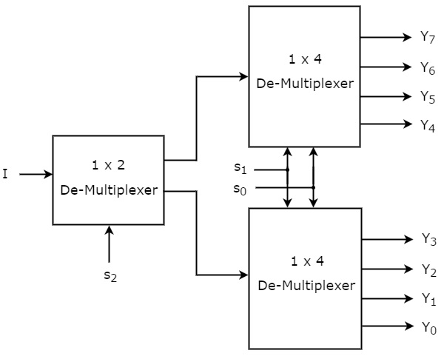
Block diagram

Slide 85
Circuit explanation
The common selection lines, s1 & s0 are applied to both 1x4 de-multiplexers.
The outputs of upper 1x4 de-multiplexer are Y7 to Y4 and the outputs of lower 1x4 de-multiplexer are Y3 to Y0.
The other selection line, s2 is applied to 1x2 de-multiplexer.
If s2 is zero, then one of the four outputs of lower 1x4 de-multiplexer will be equal to input, I based on the values of selection lines s1 & s0.
Similarly, if s2 is one, then one of the four outputs of upper 1x4 demultiplexer will be equal to input, I based on the values of selection lines s1 & s0.

Slide 86
1x16 De-Multiplexer
1x16 de-multiplexer using 1x8 de-multiplexers and 1x2 de-multiplexer. reas, 1x16 de-multiplexer has single input, four selection lines and sixteen outputs.
So, we require two 1x8 de-multiplexers in second stage in order to get the final sixteen outputs.
Since, the number of inputs in second stage is two, we require 1x2 demultiplexer in first stage so that the outputs of first stage will be the inputs of second stage.
Input of this 1x2 de-multiplexer will be the overall input of 1x16 de-multiplexer.

Slide 87
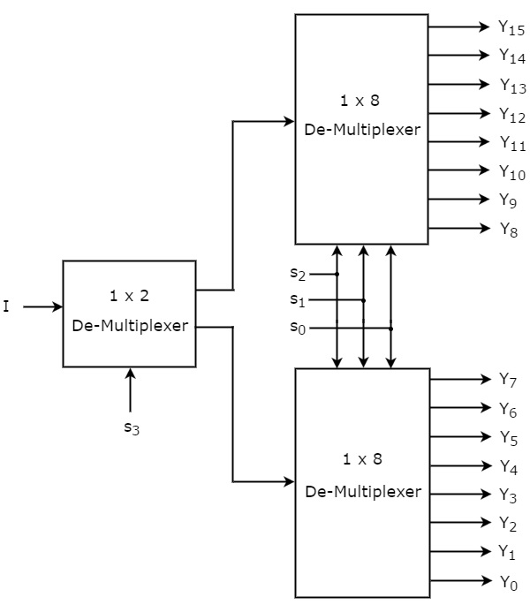
Block diagram

Slide 88
Circuit explanation
The common selection lines s2, s1 & s0 are applied to both 1x8 de-multiplexers. The outputs of upper 1x8 de-multiplexer are Y15 to Y8 and the outputs of lower 1x8 demultiplexer are Y7 to Y0.
The other selection line, s3 is applied to 1x2 de-multiplexer.
If s3 is zero, then one of the eight outputs of lower 1x8 de-multiplexer will be equal to input, I based on the values of selection lines s2, s1 & s0.
Similarly, if s3 is one, then one of the 8 outputs of upper 1x8 de-multiplexer will be equal to input, I based on the values of selection lines s2, s1 & s0.

Slide 89
Encoders

Slide 90
Encoders
An encoder is a combinational circuit that performs the reverse operation of decoder.
It has maximum of 2^{n} input lines and ‘n’ output lines.
It will produce a binary code equivalent to the input, which is active high.
Therefore, the encoder encodes 2^{n} input lines with ‘n’ bits.

Slide 91
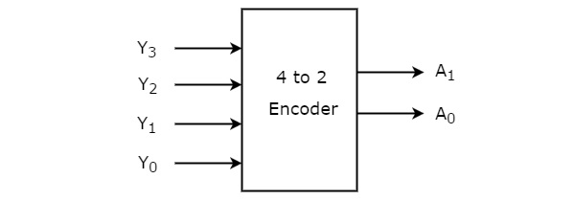
4 to 2 Encoder
Let 4 to 2 encoder has four inputs Y₃, Y₂, Y₁ & Y₀ and two outputs A₁ & A₀.
At any time, only one of these 4 inputs can be ‘1’ in order to get the respective binary code at the output.
Boolean functions for each output as
A1=Y3+Y2
A0=Y3+Y1

Slide 92
Truth table of 4 to 2 encoder
Inputs |  |  |  | Outputs
Y₃ | Y₂ | Y₁ | Y₀ | A₁ | A₀
0 | 0 | 0 | 1 | 0 | 0
0 | 0 | 1 | 0 | 0 | 1
0 | 1 | 0 | 0 | 1 | 0
1 | 0 | 0 | 0 | 1 | 1

Slide 93
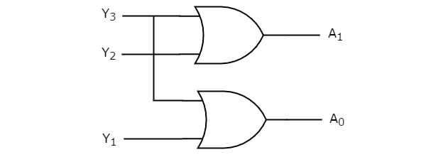
Logic circuit

Slide 94
Octal to Binary Encoder
Octal to binary Encoder has eight inputs, Y₇ to Y₀ and three outputs A₂, A₁ & A₀. Octal to binary encoder is nothing but 8 to 3 encoder.
At any time, only one of these eight inputs can be ‘1’ in order to get the respective binary code.

Slide 95
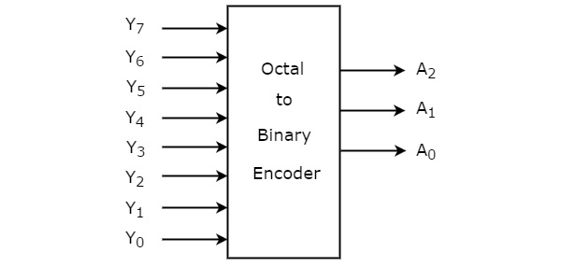
Block diagram

Slide 96
Truth table of octal to binary encoder
Inputs |  |  |  |  |  |  |  | Outputs
Y₇ | Y₆ | Y₅ | Y₄ | Y₃ | Y₂ | Y₁ | Y₀ | A₂ | A₁ | A₀
0 | 0 | 0 | 0 | 0 | 0 | 0 | 1 | 0 | 0 | 0
0 | 0 | 0 | 0 | 0 | 0 | 1 | 0 | 0 | 0 | 1
0 | 0 | 0 | 0 | 0 | 1 | 0 | 0 | 0 | 1 | 0
0 | 0 | 0 | 0 | 1 | 0 | 0 | 0 | 0 | 1 | 1
0 | 0 | 0 | 1 | 0 | 0 | 0 | 0 | 1 | 0 | 0
0 | 0 | 1 | 0 | 0 | 0 | 0 | 0 | 1 | 0 | 1
0 | 1 | 0 | 0 | 0 | 0 | 0 | 0 | 1 | 1 | 0
1 | 0 | 0 | 0 | 0 | 0 | 0 | 0 | 1 | 1 | 1

Slide 97
Boolean functions
Boolean functions for each output as
  2=y7+y6+y5+y4
  A1=y7+y6+y3+y2
  A0=y7+y5+y3+y1

Slide 98
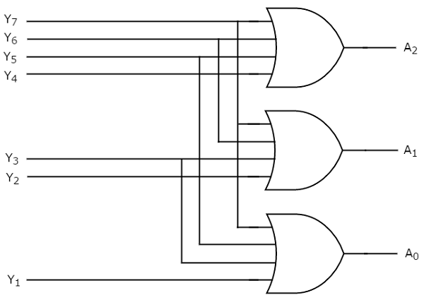
Logic circuit

Slide 99
Drawbacks of Encoder
Following are the drawbacks of normal encoder.
There is an ambiguity, when all outputs of encoder are equal to zero. Because, it could be the code corresponding to the inputs, when only least significant input is one or when all inputs are zero.
If more than one input is active high, then the encoder produces an output, which may not be the correct code. For example, if both Y₃ and Y₆ are ‘1’, then the encoder produces 111 at the output. This is neither equivalent code corresponding to Y₃, when it is ‘1’ nor the equivalent code corresponding to Y₆, when it is ‘1’.

Slide 100
Decoders

Slide 101
decoders
The combinational circuit that change the binary information into 2^{N} output lines is known as decoders.
In simple words, the decoder performs the reverse operation of the encoder. At a time, only one input line is activated for simplicity.
The produced 2^{n}-bit output code is equivalent to the binary information.
A particular application of decoder is a Binary-to-Octal conversion.

Slide 102
Types of decoders
2 to 4 line decoder
3 to 8 line decoder
4 to 16 line Decoder

Slide 103
2 to 4 line decoder
In the 2 to 4 line decoder, there is a total of three inputs, i.e., A₀, and A₁ and E and four outputs, i.e., Y₀, Y₁, Y₂, and Y₃.
For each combination of inputs, when the enable 'e' is set to 1, one of these four outputs will be 1.

Slide 104
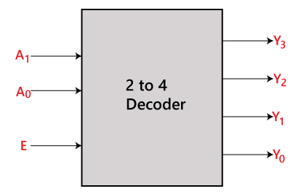
Block diagram

Slide 105
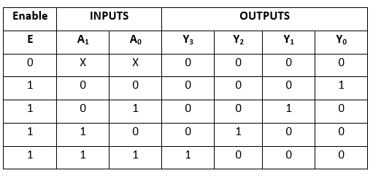
Truth table

Slide 106
Logical expression
The logical expression of the term Y0, Y0, Y2, and Y3 is as follows:
        Y3=E.A1.A0
        Y2=E.A1.A0'
        Y1=E.A1'.A0
        Y0=E.A1'.A0'

Slide 107
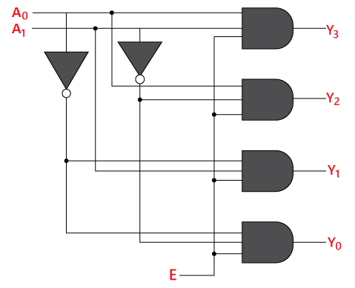
Logic circuit

Slide 108
3 to 8 line decoder
The 3 to 8 line decoder is also known as binary to octal decoder.
In a 3 to 8 line decoder, there is a total of eight outputs, i.e., Y₀, Y₁, Y₂, Y₃, Y₄, Y₅, Y₆, and Y₇ and three outputs, i.e., A₀, A1, and A₂.
This circuit has an enable input 'E'. Just like 2 to 4 line decoder, when enable 'E' is set to 1, one of these four outputs will be 1.

Slide 109
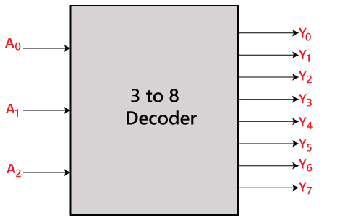
Block diagram

Slide 110
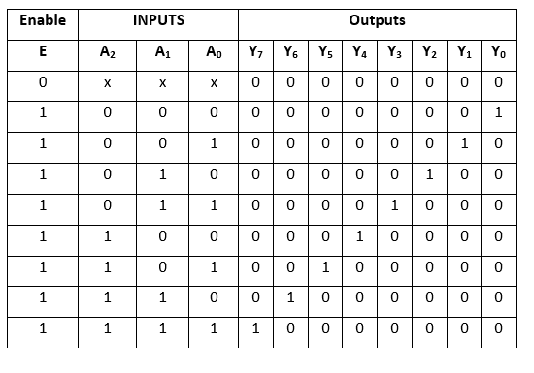
Truth table

Slide 111
Logical expression
The logical expression of the term Y₀, Y₁, Y₂, Y₃, Y₄, Y₅, Y₆, and Y₇ is as follows:
        Y₀=A₀'.A₁'.A₂'
        Y₁=A₀.A₁'.A₂'
        Y₂=A₀'.A₁.A₂'
        Y₃=A₀.A₁.A₂'
        Y₄=A₀'.A₁'.A₂
        Y₅=A₀.A₁'.A₂
        Y₆=A₀'.A₁.A₂
        Y₇=A₀.A₁.A₂

Slide 112
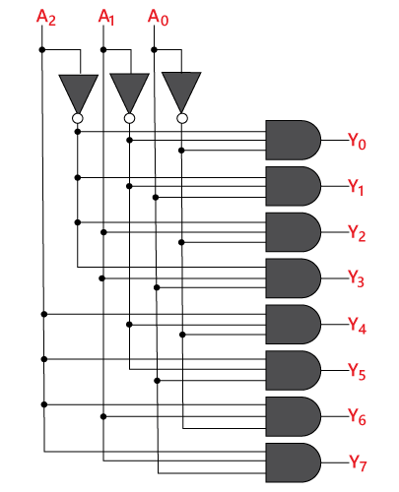
Logic circuit

Slide 113
4 to 16 line Decoder
In the 4 to 16 line decoder, there is a total of 16 outputs, i.E., Y₀, Y₁, Y₂,……, Y₁₆ and four inputs, i.E., A₀, A1, A₂, and A₃.
The 3 to 16 line decoder can be constructed using either 2 to 4 decoder or 3 to 8 decoder.

Slide 114
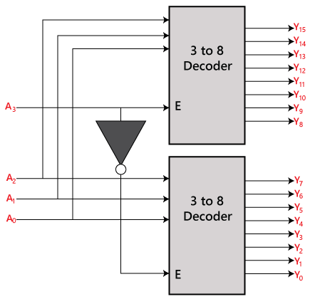
Block diagram

Slide 115
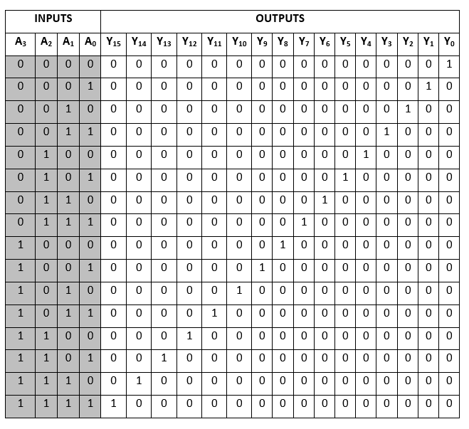
Truth table

Slide 116
Logical expression
The logical expression of the term A0, A1, A2,…, A15 are as follows:
    Y₀=A₀'.A₁'.A₂'.A₃‘ Y₁=A₀'.A₁'.A₂'.A₃
    Y₂=A₀'.A₁'.A₂.A₃‘ Y₃=A₀'.A₁'.A₂.A₃
    Y₄=A₀'.A₁.A₂'.A₃‘ Y₅=A₀'.A₁.A₂'.A₃
    Y₆=A₀'.A₁.A₂.A₃‘ Y₇=A₀'.A₁.A₂.A₃
    Y₈=A₀.A₁'.A₂'.A₃‘ Y₉=A₀.A₁'.A₂'.A₃
    Y₁₀=A₀.A₁'.A₂.A₃‘ Y₁₁=A₀.A₁'.A₂.A₃
    Y₁₂=A₀.A₁.A₂'.A₃‘ Y₁₃=A₀.A₁.A₂'.A₃
    Y₁₄=A₀.A₁.A₂.A₃‘ Y₁₅=A₀.A₁.A₂'.A₃

Slide 117
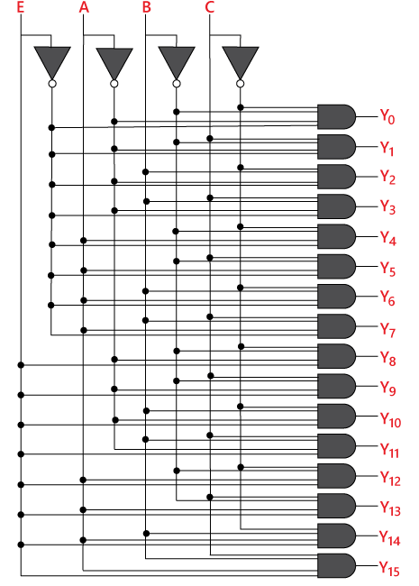
Logic circuit

Slide 118
Combinational circuits

Slide 119
Combinational circuits
Combinational Circuits (CC) Are circuits made up of different types of logic gates.
A logic gate is a basic building block of any electronic circuit.
The output of the combinational circuit depends on the values at the input at any given time.
The circuits do not make use of any memory or storage device.

Slide 120
Characteristics of combinational circuits
The output of combinational circuit at any instant of time, depends only on the levels present at input terminals.
The combinational circuit do not use any memory. The previous state of input does not have any effect on the present state of the circuit.
A combinational circuit can have an n number of inputs and m number of outputs.

Slide 121
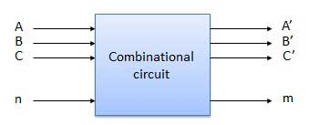
Block diagram

Slide 122
Combinational Circuit Types
Some of the most common combinational circuits are:
  Arithmetic building blocks
    Adder
    Subtractor
    Parallel adder and subtractor
  Multiplexers
  Demultiplexers
  Encoders
  Decoders

Slide 123
Arithmetic building blocks
Arithmetic building blocks are the circuits made up of basic logic gates which are used to perform arithmetic operations.
  Some of them are
    Half adder
    Full adder
    Half subtractor
    Full subtractor
    Parallel adder

Slide 124
Half adder
Half adder is a combinational logic circuit with two inputs and two outputs.
The half adder circuit is designed to add two single bit binary number A and B.
It is the basic building block for addition of two single bit numbers.
This circuit has two outputs carry and sum.

Slide 125
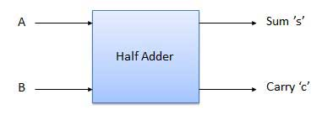
Block diagram

Slide 126
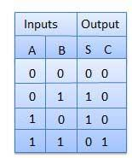
Truth table

Slide 127
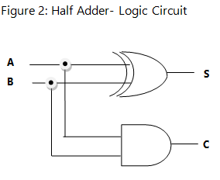
Logic circuit

Slide 128
Boolean expression
The Boolean expression for the half adder circuit is given as,
    Sum = a’b +ab’
    Carry = ab

Slide 129
Full adder

Slide 130
Full adder
Full adder is developed to overcome the drawback of half adder circuit.
It can add two one-bit numbers A and B, and carry c.
The full adder is a three input and two output combinational circuit.

Slide 131
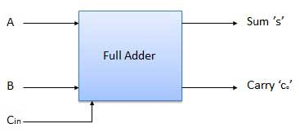
Block diagram

Slide 132
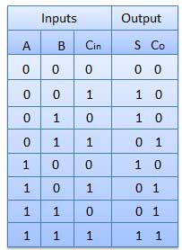
Truth table

Slide 133

Logic circuit

Slide 134
Boolean expression
The Boolean expression for the half adder circuit is given as,
    Sum = (A ⊕ B) ⊕ C_{in}
    Carry = A.B + (A ⊕ B)

Slide 135
Half and Full Subtractor

Slide 136
Half subtractor
The half subtractor is also a building block for subtracting two binary numbers.
It has two inputs and two outputs.
This circuit is used to subtract two single bit binary numbers A and B.
The 'diff' and 'borrow' are two output states of the half subtractor.

Slide 137

Block diagram

Slide 138

Truth table

Slide 139

Logic circuit

Slide 140
Boolean expression
The Boolean expression for the half subtractor circuit is given as,
    Diff= A'B+AB‘
    Borrow = A'B

Slide 141
Full subtractor
The full subtractor is used to subtract three 1-bit numbers A, B, and C, which are minuend, subtrahend, and borrow, respectively.
The full subtractor has three input states and two output states i.e., Diff and borrow.

Slide 142

Block diagram

Slide 143

Truth table

Slide 144

Logic circuit

Slide 145
Boolean expression
The Boolean expression for the full subtractor circuit is given as,
    Diff = (A ⊕ B) ⊕ 'Borrow_{in‘}
    Borrow = A'.B + (A ⊕ B)'

Slide 146
2’s complement adder/subtractor
A binary/2’s complement adder-subtractor is a special type of circuit that is used to perform both operations, i.e., Addition and subtraction. The operation which is going to be used depends on the values contained by the control signal. In arithmetic logical unit, it is one of the most important components.
To work with binary adder-subtractor, it is required that we have knowledge of the EXOR gate, full-adder, binary addition, and subtraction.

Slide 147
2’s complement subtraction
To perform 2’s complement subtraction perform the following steps
  Step1 : find the 2’s complement of subtrahend
  Step2 : add first number(minuend) and 2’s complement of subtrahend
  Step3 : if carry is produced in the addition, discard the carry. If there is no carry, take 2’s complement for the sum and assign negative sign.

Slide 148
EXAMPLE
(1111) – (1001) = (?)
  1’S COMPLEMENT OF 1001 → 0110
  2’S COMPLEMENT OF 1001 → 0110 + 1 → 0111
  NOW SUBTRACT
    1111-
    0111
    --------
    10110

Slide 149
2’S COMPLEMENT ADDED/SUBTRACTOR
To perform addition, A3 A2 A1 A0 & B3 B2 B1 B0 bits are taken as it is and cy_{in.}
To perform subtraction, B3 B2 B1 B0 bits are passed through EXOR gate and cy_{in} kept as 1.

Slide 150

Block diagram

Slide 151

Logic diagram

Slide 152
ARITHMETIC MICROOPERATIONS

Slide 153
CATEGORIES OF ARITHMETIC OPERATIONS
The arithmetic micro-operations deals with the operations performed on numeric data stored in the registers.
The basic arithmetic micro-operations are classified in the following categories:
Addition
Subtraction
Increment
Decrement
Shift

Slide 154
ADDITIONAL ARITHMETIC MICROOPERATIONS
Some additional arithmetic micro-operations are classified as:
Add with carry
Subtract with borrow
Transfer/load

Slide 155
SYMBOLIC REPRESENTATION
Symbolic Representation | Description
R3 ← R1 + R2 | The contents of R1 plus R2 are transferred to R3.
R3 ← R1 - R2 | The contents of R1 minus R2 are transferred to R3.
R2 ← R2' | Complement the contents of R2 (1's complement)
R2 ← R2' + 1 | 2's complement the contents of R2 (negate)
R3 ← R1 + R2' + 1 | R1 plus the 2's complement of R2 (subtraction)
R1 ← R1 + 1 | Increment the contents of R1 by one
R1 ← R1 - 1 | Decrement the contents of R1 by one

Slide 156

ADDITION
In addition micro-operation, the value in register R1 is added to the value in the register R2 and then the sum is transferred into register R3.

Slide 157


SUBTRACTION
In subtraction micro-operation, the contents of register R2 are subtracted from contents of the register R1, and then the result is transferred into R3.
There is another way of doing the subtraction. In this, 2’s complement of R2 is added to R1, which is equivalent to R1 – R2, and then the result is transferred into register R3.

Slide 158


INCREMENT & DECREMENT
Increment –
In increment micro-operation, the value inside the R1 register is increased by 1.
Decrement –
In decrement micro-operation, the value inside the R1 register is decreased by 1.

Slide 159

1’ S COMPLEMENT
In this micro-operation, the complement of the value inside the register R1 is taken.

Slide 160

2’S COMPLEMENT
In this micro-operation, the complement of the value inside the register R2 is taken and then 1 is added to the value and then the final result is transferred into the register R2. This process is also called negation. It is equivalent to -R2.

Slide 161
Binary adder
The add micro-operation requires registers that can hold the data and the digital components that can perform the arithmetic addition.
A binary adder is a digital circuit that performs the arithmetic sum of two binary numbers provided with any length.
A binary adder is constructed using full-adder circuits connected in series, with the output carry from one full-adder connected to the input carry of the next full-adder.

Slide 162

Block diagram – 4 bit binary adder

Slide 163
Circuit explanation
The augend bits (A) and the addend bits (B) are designated by subscript numbers from right to left, with subscript '0' denoting the low-order bit.
The carry inputs starts from c0 to c3 connected in a chain through the full-adders. C4 is the resultant output carry generated by the last full-adder circuit.
The output carry from each full-adder is connected to the input carry of the next-high-order full-adder.
The sum outputs (s0 to s3) generates the required arithmetic sum of augend and addend bits.
The n data bits for the a and b inputs come from different source registers. For instance, data bits for A input comes from source register R1 and data bits for B input comes from source register R2.
The arithmetic sum of the data inputs of a and b can be transferred to a third register or to one of the source registers (r1 or r2).

Slide 164
Parallel adder

Slide 165
Parallel adder
Adders are the combinatorial circuits which are used to add two binary numbers.
The nature of the adders chosen depends on the characteristics of the binary numbers which need to be added.
Say for example, if one needs to add two single bit binary digits, then one can use half adder while if there is an additional carry which needs to be added along with them, then one may resort to the use of full adder.
However what if we want to add a binary number which has multiple bits in it. In such a case, the need arises to use a parallel adder.

Slide 166
Structure of Parallel Adder
Parallel adder is nothing but a cascade of several full adders. The number of full adders used will depend on the number of bits in the binary digits which require to be added.
An n-bit adder formed by cascading n full adders (FA₁ to FA_{n}) is used to add two n-bit binary numbers.

Slide 167

N – BIT PARALLEL ADDER LOGIC CIRCUIT

Slide 168
Circuit explanation
Here, every single bit of the numbers to be added is provided at the input pins of every single full adder.
That is, the first bits A₁ and B₁ are provided as the inputs to full adder (FA₁), the second bits A₂ and B₂ to the inputs of full adder 2 (FA₂)… and the last bits a_{n} and b_{n} to the n^{th} full adder fa_{n}.
Next, the carry out pin of each full adder in the circuit is connected to the carry in pin of its succeeding full adder (except in the case of last full adder). For example, the carry out pin of FA₁ (co₁) is connected to carry in pin of FA₂ (ci₂), the carry out pin of FA₂ (co₂) is connected to carry in pin of FA₃ (ci₃) and so on and so forth.

Slide 169
Working of Parallel Adder
First, FA₁ adds A₁ with B₁ to generate S₁ (the first bit of sum output) and co₁.
Next, FA₂ uses this co₁ as its carry in bit and adds it with its input bits A₂ and B₂ to generate the second bit of the sum output S₂ and co₂.
Next, this co₂ is considered as an input by FA₃ which adds it with the bits A₃ and B₃.
This process continues till the nth full adder in the sequence which adds the carry out bit of (n-1)^{th} full adder (co_{n-1}) with its inputs a_{n} and b_{n}.
When this happens, we would get the output bits s_{n} and co_{n} which are the last bits of our sum output and the expected carry bit, respectively.

Slide 170
Drawback of Parallel Adders
In the case of n-bit parallel adder, each adder has to wait for the carry term to be generated from its preceding adder in order to finish its task of adding.
This can be visualized as if the carry term propagates along the chain in the fashion of a ripple. Thus these kind of adders are even referred to as ripple carry adders.
Further, the delay associated with the travelling of carry bit is called carry propagation delay and is found to worsen with an increase in the length of the binary numbers, which require to be added.
For example, if each full adder is considered to have a delay of 10 ns, then the total delay required to produce the output of a 4-bit parallel adder would be 4 × 10 = 40 ns.

Slide 171
REGISTER TRANSFER LANGUAGE

Slide 172
DIGITAL SYSTEM
A digital system is an interconnection of digital hardware modules that accomplish a specific information processing task.
The modules are constructed from registers, decoders, arithmetic elements and control logic.

Slide 173
MICRO OPERATION
A micro operation is an elementary operation performed on the information stored in one or more registers.
Example: shift, clear, and load.

Slide 174
REGISTER TRANSFER LANGUAGE (RTL)
In symbolic notation, it is used to describe the micro-operations transfer among registers.
It is a kind of Intermediate Representation (IR) that is very close to assembly language, such as that which is used in a compiler.
The term “Register Transfer” can perform micro-operations and transfer the result of operation to the same or other register.

Slide 175
REGISTERS
Computer registers are designated by capital letters to denote the function of the registers
Example:
MAR → MEMORY ADDRESS REGISTER
PC → PROGRAM COUNTER
ir → instruction register
ri → processor register

Slide 176
Representation of registers
General way of representing a register is by the name of the register inclosed in a rectangular box as shown in (a).
Register is numbered in a sequence of 0 to (n-1) as shown in (b).
The numbering of bits in a register can be marked on the top of the box as shown in (c).
4. A 16-bit register PC is divided into 2 parts- bits (0 to 7) are assigned with lower byte of 16-bit address and bits (8 to 15) are assigned with higher bytes of 16-bit address as shown in (d).

Slide 177

Block diagram of registers

Slide 178
Register transfer
The information transferred from one register to another register is represented in symbolic form by replacement operator is called register transfer.
In the statement, R2 <- R1, <- acts as a replacement operator. This statement defines the transfer of content of register R1 into register R2.

Slide 179
Basic symbols of rtl
SYMBOL | DESCRIPTION | EXAMPLE
Letters and Numbers | Denotes a Register | MAR, R1, R2
( ) | Denotes a part of register | R1(8-bit) R1(0-7)
<- | Denotes a transfer of information | R2 <- R1

Slide 180
Basic symbols of rtl
SYMBOL | DESCRIPTION | EXAMPLE
, | Specify two micro-operations of Register Transfer | R1 <- R2 R2 <- R1
: | Denotes conditional operations | P : R2 <- R1 if P=1
Naming Operator (:=) | Denotes another name for an already existing register/alias | Ra := R1

Slide 181
Register Transfer Operations
The operation performed on the data stored in the registers are referred to as register transfer operations.
There are different types of register transfer operations:
1. Simple Transfer – R2 <- R1
2. Conditional Transfer – p: r2<- r1
3. Simultaneous TRANSFER – p: r2<- r1, r1<-r2

Slide 182
Simple register transfer
The content of R1 are copied into R2 without affecting the content of R1. It is an unconditional type of transfer operation.
Example:
  R2 <- R1

Slide 183
CONDITIONAL TRANSFER
It indicates that if P=1, then the content of R1 is transferred to R2. It is a unidirectional operation.
  If (P=1) then (R2<-R1)
Control function:
A control function P is a Boolean variable that is equal to 1 or 0 and is specified as P: R2<-R1
The control condition is terminated with a colon
It symbolizes the requirement that the transfer operation can be executed by the hardware only if P = 1

Slide 184

BLOCK AND TIMING DIAGRAM

Slide 185
SIMULTANEOUS TRANSFER
If 2 or more operations are to occur simultaneously then they are separated with comma (,).
if the control function P=1, then load the content of R1 into R2 and at the same clock load the content of R2 into R1.

Slide 186

SIMULTANEOUS TRANSFER

Slide 187

Types of microoperations

Slide 188
4 – bit binary arithmetic circuit

Slide 189
Arithmetic circuit
The circuit which performs different types of arithmetic operations by controlling the data inputs to the adder is called an arithmetic circuit.

Slide 190

Block diagram

Slide 191
Circuit explanation
The circuit has 4 full adder circuits that constitute the 4-bit adder and 4 multiplexers.
There are two 4 bit inputs A & B and one 4-bit output D.
The input A goes directly to X and B inputs are connected to the inputs of the multiplexers.

Slide 192
Circuit explanation
The multiplexers also receive the complement of B.
The other two inputs are connected to logic 0 and logic 1.
The multiplexers are controlled by S0 and S1.
The input carry Cin goes to the carry input of FA in the least position.

Slide 193
Addition & subtraction
  S1S0 = 00, d = a+b if cin=0
    d = a+B+1 if cin = 1
  S1s0 = 01, d = a+b’ if cin=0
    d = a+B’+1 if cin = 1

Slide 194
Increment & decrement
  S1S0 = 10, d = a+0+cin if cin=0
    d = a+1 if cin = 1
  S1s0 = 11, d = a-1 if cin=0
    d = a-1+1 if cin = 1

Slide 195

Function table

Slide 196
Central processing unit

Slide 197
Features of cpu
Central processing unit (CPU) consists of the following features −
CPU is considered as the brain of the computer.
CPU performs all types of data processing operations.
It stores data, intermediate results, and instructions (program).
It controls the operation of all parts of the computer.

Slide 198

Components of cpu
CPU itself has following three components.
  Memory or storage unit
  Control unit
  ALU(arithmetic logic unit)

Slide 199
Memory unit
This unit can store instructions, data, and intermediate results. This unit supplies information to other units of the computer when needed. It is also known as internal storage unit or the main memory or the primary storage or random access memory (RAM).
Its size affects speed, power, and capability. Primary memory and secondary memory are two types of memories in the computer. Functions of the memory unit are −
It stores all the data and the instructions required for processing.
It stores intermediate results of processing.
It stores the final results of processing before these results are released to an output device.
All inputs and outputs are transmitted through the main memory.

Slide 200
Control unit
This unit controls the operations of all parts of the computer but does not carry out any actual data processing operations.
Functions of this unit are −
It is responsible for controlling the transfer of data and instructions among other units of a computer.
It manages and coordinates all the units of the computer.
It obtains the instructions from the memory, interprets them, and directs the operation of the computer.
It communicates with input/output devices for transfer of data or results from storage.
It does not process or store data.

Slide 201
alu
This unit consists of two subsections namely,
  Arithmetic section
  Logic section
Arithmetic section - Function of arithmetic section is to perform arithmetic operations like addition, subtraction, multiplication, and division. All complex operations are done by making repetitive use of the above operations.
Logic section - Function of logic section is to perform logic operations such as comparing, selecting, matching, and merging of data.

Slide 202
General Register organization
Generally CPU has seven general registers. Register organization show how registers are selected and how data flow between register and ALU. A decoder is used to select a particular register. The output of each register is connected to two multiplexers to form the two buses A and B. The selection lines in each multiplexer select the input data for the particular bus.
The a and b buses form the two inputs of an ALU. The operation select lines decide the micro operation to be performed by ALU. The result of the micro operation is available at the output bus. The output bus connected to the inputs of all registers, thus by selecting a destination register it is possible to store the result in it.

Slide 203

A bus organization for seven CPU register

Slide 204
Register and multiplexer input selection code
Binary code | SELA | SELB | SELD or SELREG
000 | Input | Input | ---
001 | R1 | R1 | R1
010 | R2 | R2 | R2
011 | R3 | R3 | R3
100 | R4 | R4 | R4
101 | R5 | R5 | R5
110 | R6 | R6 | R6
111 | R7 | R7 | R7

Slide 205
Operation with symbol
Operation selection code | Operation | symbol
0000 | Transfer A | TSFA
0001 | Increment A | INC A
0010 | A+B | ADD
0011 | A-B | SUB
0100 | Decrement A | DEC
0101 | A AND B | AND
0110 | A OR B | OR
0111 | A XOR B | XOR
1000 | Complement A | COMA
1001 | Shift right A | SHR
1010 | Shift left A | SHL

Slide 206
What is CONTROL WORD?
The combined value of a binary selection inputs specifies the control word.
It consist of four fields SELA,SELB,and SELD or SELREG contains three bit each and selopr field contains four bits thus the total bits in the control word are 13-bits.
SEL A | SELB | SELREG OR SELD | SELOPR

Slide 207
FORMAT OF CONTROL WORD
1. The three bit of SELA select a source registers of the a input of the ALU.
2. The three bits of SELB select a source registers of the b input of the ALU.
3. The three bits of SELED or SELREG select a destination register using the
decoder.
4. The four bits of SELOPR select the operation to be performed by ALU.

Slide 208
EXAMPLE
• To perform the operation R3 = R1+R2 We have to provide following
binary selection variable to the select inputs.
1. SEL A : 001 -To place the contents of R1 into bus A.
2. SEL B : 010 - to place the contents of R2 into bus B
3. SEL OPR : 0010 – to perform the arithmetic addition A+B
4. SEL REG or SEL D : 011 – to place the result available on output bus in R3.

Slide 209
Stack organization

Slide 210
stack
Stack is a storage device that stores information in such a manner that the item stored at last is the first item retrieved.
It uses Last In First Out(LIFO) method.

Slide 211
Stack top and stack pointer
Stack Top:
  Address of the Top element that is stored in a stack is called stack top.
Stack Pointer:
  The register that holds the address of the stack top is called stack pointer.

Slide 212
Register stack
A stack can be placed in a portion of a large memory or it can be organized as a collection of a finite number of memory words or registers.
Following Figure shows the organization of a 64-word register stack.
DR: is a register that holds the binary data to be written into or read out of the stack.

Slide 213

Block diagram of a 64 word stack
The stack pointer register SP contains a binary number whose value is equal to the address of the word that is currently on top of the stack.
Three items are placed in the stack: A, B, and C, in that order.
Item C is on top of the stack so that the content of SP is now 3.

Slide 214
Operations on stack
The operations of a stack are simulated by incrementing or decrementing the SP register.
PUSH: the operation of insertion is called push, which results in pushing a new item on top.
POP: the operation of deletion is called pop, which results in removing one item from stack.

Slide 215
Push operation
The push operation is implemented with the following sequence of microoperations;
SP ← SP + 1 Increment stack pointer
M[SP] ← DR Write item on top of the stack
If (SP = 0) then (FULL ←1) Check if stack is full
EMTY ← 0 Mark the stack not empty

Slide 216
Push operation
The stack pointer is incremented so that it points to the address of the next-higher word. A memory write operation inserts the word from DR into the top of the stack. Note that SP holds the address of the top of the stack and that M[SP] denotes the memory word specified by the address presently available in SP.
The first item stored in the stack is at address l the last item is stored at address 0.
If sp reaches 0, the stack is full of items, so full is set to l this condition is reached if the top item prior to the last push was in location 63 and, after incrementing sp, the last item is stored in location 0.
Once an item is stored in location 0, there are no more empty registers in the stack. If an item is written in the stack, obviously the stack cannot be empty, so EMTY is cleared to 0.

Slide 217
Pop operation
The pop operation consists of the following sequence of microoperations:
DR ← M[SP] Read item from the top of stack
SP ← SP - 1 Decrement stack pointer
If (SP = 0) then (EMTY ← 1) Check if stack is empty
FULL ← 0 Mark the stack not full

Slide 218
Pop operation
The top item is read from the stack into DR . the stack pointer is then decremented. If its value reaches zero, the stack is empty, so EMTY is set to 1.
This condition is reached if the item read was in location 1. Once this item is read out, SP is decremented and reaches the value 0, which is the initial value of SP. Note that if a pop operation reads the item from location 0 and then SP is decremented, SP changes to 111111, which is equivalent to decimal 63.
In this configuration, the word in address 0 receives the last item in the stack. Note also that an erroneous operation will result if the stack is pushed when FULL = 1 or popped when EMTY = 1.

Slide 219
MEMORY STACK
The implementation of a stack in the CPU is done by assigning a portion of memory to a stack operation and using a processor register as a stack pointer.
A portion of computer memory is partitioned into three segments
  Program
  Data
  Stack

Slide 220

COMPUTER MEMORY WITH PROGRAM, DATA & STACK SEGMENTS

Slide 221
Registers of memory stack
The PROGRAM COUNTER (PC): points at the address of the next instruction in the program. PC is used during the fetch phase to read an instruction.
The ADDRESS REGISTER(AR): points at an array of data. AR is used during the fetch phase to read an operand.
The STACK POINTER(SP): points at the top of the stack. SP is used to push or pop items from or to the stack

Slide 222
Stack limits
Stack limits can be checked by using two processor registers:
  One to hold the upper limit
  Other to hold the lower limit

Slide 223
Operations on memory stack
Push:
  SP ← SP - 1
  M[SP] ← DR
Pop:
  DR ← M[SP]
  SP ← SP + 1

Slide 224
Instruction format
A computer will usually have a variety of instruction code formats. It is the function of the control unit within the CPU to interpret each instruction code and provide the necessary control functions needed to process the instruction.
The format of an instruction is usually depicted in a rectangular box symbolizing the bits of the instruction as they appear in memory words or in a control register.

Slide 225
Instruction format
The bits of the instruction are divided into groups called fields. The most common fields found in instruction formats are:
1. An operation code field that specifies the operation to be performed.
2. An address field that designates a memory address or a processor
register.
3. A mode field that specifies the way the operand or the effective address
is determined.

Slide 226
Cpu organization
The number of address fields in the instruction format of a computer depends on the internal organization of its registers.
Most computers fall into one of three types of CPU organizations:
1. Single accumulator organization.
2. General register organization.
3. Stack organization.

Slide 227
Three-Address Instructions
Computers with three-address instruction formats can use each address field to specify either a processor register or a memory operand. The program in assembly language that evaluates X = (A + B) * (C + D) is shown below, together with comments that explain the register transfer operation of each instruction.
ADD R1, A, B R1 ← M[A] + M[B]
ADD R2, C, D R2 ← M[C] + M[D]
MOL X, R1, R2 M[X] ← R1 * R2

Slide 228
Three-Address Instructions
It is assumed that the computer has two processor registers, R1 and R2. The symbol M[A] denotes the operand at memory address symbolized by A.
The advantage of the three-address format is that it results in short programs when evaluating arithmetic expressions.
The disadvantage is that the binary-coded instructions require too many bits to specify three addresses.

Slide 229
Two-Address Instructions
Two-address instructions are the most common in commercial computers. Here again each address field can specify either a processor register or a memory word. The program to evaluate X = (A + B) * (C + D) is as follows:
MOV R1, A R1 ← M[A]
ADD R1, B R1 ← R1 + M[B]
MOV R2, C R2 ← M[C]
ADD R2, D R2 ← R2 + M[D]
MOL R1, R2 R1 ← R1 * R2
MOV X, R1 M[X] ← R1

Slide 230
Two-Address Instructions
Two-address instructions are the most common in commercial computers. Here again each address field can specify either a processor register or a memory word. The program to evaluate X = (A + B) * (C + D) is as follows:
      MOV R1, A R1 ← M[A]
      ADD R1, B R1 ← R1 + M[B]
      MOV R2, C R2 ← M[C]
      ADD R2, D R2 ← R2 + M[D]
      MOL R1, R2 R1 ← R1 * R2
      MOV X, R1 M[X] ← R1
The MOV instruction moves or transfers the operands to and from memory and processor registers.
The first symbol listed in an instruction is assumed to be both a source and the destination where the result of the operation is transferred.

Slide 231
One-Address Instructions
One-address instructions use an implied accumulator (AC) register for all data manipulation. For multiplication and division there is a need for a second register. However, here we will neglect the second register and assume that the AC contains the result of all operations.
The program to evaluate X = (A + B) * (C + D) is
    LOAD A AC ← M[AJ
    ADD B AC ← AC + M[B]
    STORE T M[T] ← AC
    LOAD c AC ← M[C]
    ADD D AC ← AC + M[D]
    MOL T AC ← AC*M[T]
    STORE X M[X] ← AC
All operations are done between the AC register and a memory operand. T is the address of a temporary memory location required for storing the intermediate result.

Slide 232
Zero-Address Instructions
A stack-organized computer does not use an address field for the instructions ADD and MUL. The PUSH and POP instructions, however, need an address field to specify the operand that communicates with the stack. The following program shows how X = (A + B) * (C + D) will be written for a stack organized computer. (TOS stands for top of stack.)
  PUSH A TOS ← A
  PUSH B TOS ← B
  ADD TOS ← (A + B)
  PUSH C TOS ← C
  PUSH D TOS ← D
  ADD TO S ← (C + D)
  MOL TOS ← (C + D)*(A + B)
  POP X M[X] ← TOS
To evaluate arithmetic expressions in a stack computer, it is necessary to convert the expression into reverse polish notation. The name "zero-address" is given to this type of computer because of the absence of an address field in the computational instructions.

Slide 233
Reference
Albert Paul Malvino, Donald P.Leach And Goutam Saha, Digital Principles And Applications, TMH, Sixth Edition,2007
Morris Mano M, Computer System Architecture, Phi, Third Edition, 2008

